Slide 1
Simultaneous Localization and Mapping (SLAM) : The Algorithm
By: Shiva Karthik Reddy Koyya

Slide 2
Contents
The proposal of the project
Standard approaches taken in the past
Different representation
Image processing
My Approach
Results
Future Work

Slide 3
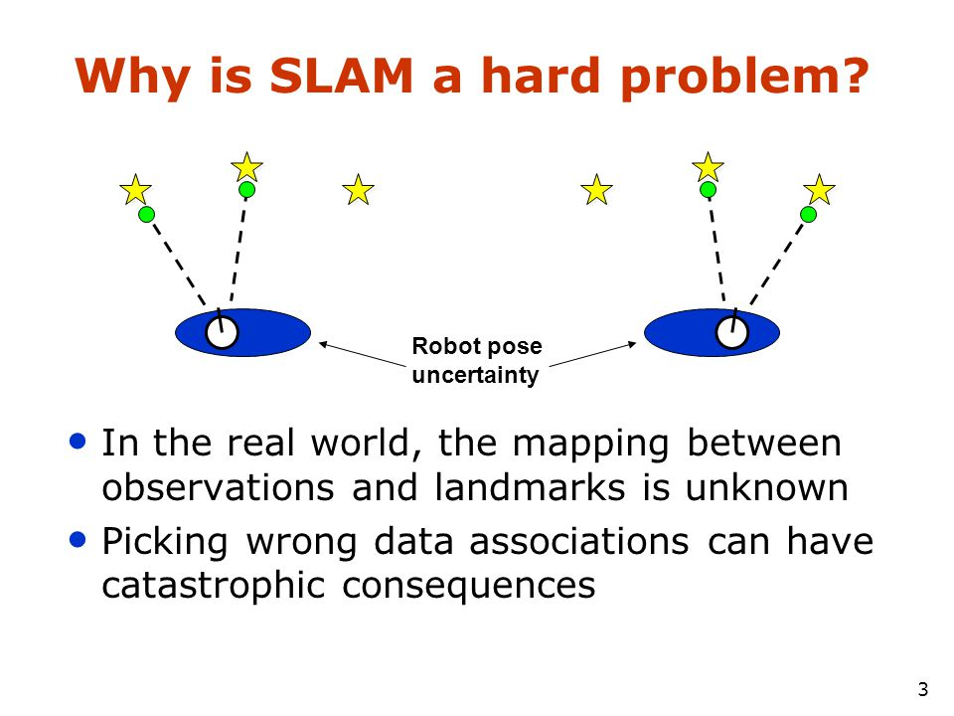
Proposal
Work on building a SLAM algorithm which is computationally effective , and robust.The algorithm was intended to be worked upon in a fashion to address the problem of data association and creating good visual maps.

Slide 4
3 Basic Paradigms used in the Literature
Kalman Filter
Extended Kalman Filter
Unscented Kalman Filter
Information filter
Extended Information filter
Sparse Information filter
2. Particle filters
3. Graph Based SLAM

Slide 5
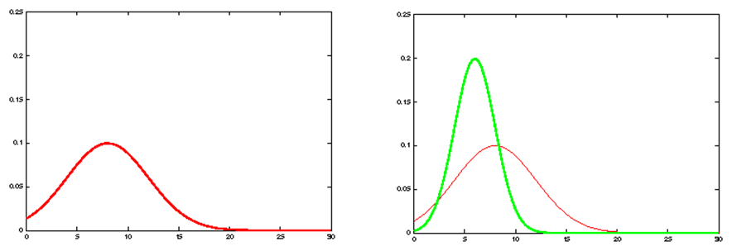
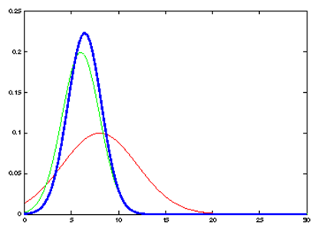
Kalman Filter

Slide 6
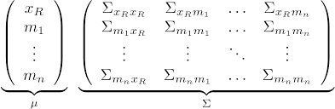
Map with N landmarks : (3+2N dimensional Gaussian)
Can handle with hundreds of dimensions
The complexity of Extended Kalman Filter is quadratic with number of landmarks.

Slide 7
Other Kalman Filters
Unscented Kalman filter : Use weighted sigma points to linearize
Information filter : Another representation of Gaussians . Using an information matrix Ω and an information vector ६.
Where the information matrix is Ω=Σ⁻¹ and ६=Σ⁻¹𝝻 the use of information filter comes into picture because it makes the update step less computationally expensive but makes prediction more expensive.
The Sparse Information filter makes approximation with the covariance matrix and utilizes the sparsity of the matrix .

Slide 8
Summary of Kalman Filters
Parameterized form use Gaussian distribution.
For linear or moderately nonlinear functions.
Unimodal Distribution.
Complexity increases quadratically with number of landmarks observed. O(n²)
Scales well only for a few 100 landmarks.
Most robust result EKF and least computationally expensive is SEIF.

Slide 9
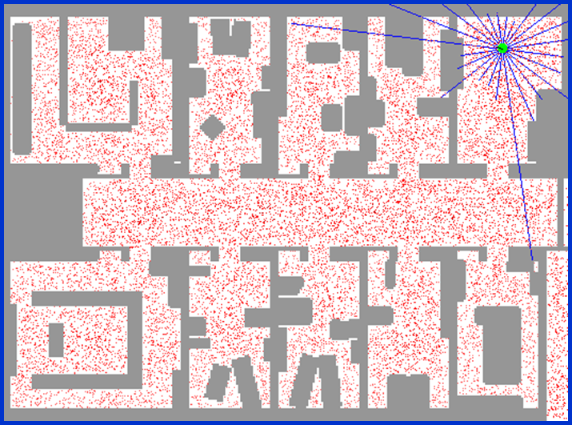
Particle Filters
Represent belief by Random Samples
Estimation of non-gaussian, nonlinear processes
Monte Carlo filter , survival of the fittest, particle filter
Importance sampling filter
Basic Idea

Slide 10
Problem with particle filters
The number of particles needed to represent the posterior grows exponentially with the dimension of the state space!
Exploit the dependency between the dimensions of the state space
The map depends on the poses of the robot. And once the poses is known building the map with known sensor is not a complex task.
P (x _{1:t} , l_{1:m} | z_{1:t} , u_{0:t-1}) = p(x _{1:t} | z_{1:t} , u_{0:t-1}) . p(l_{1:m} | x _{1:t,} z_{1:t})
SLAM posterior Robot Path Posterior Landmark Positions
Knowledge of the robot’s true path renders landmark position conditionally independent.

Slide 11
Rao Blackwellization - FastSLAM
P (x _{1:t} , l_{1:m} | z_{1:t} , u_{0:t-1}) = p(x _{1:t} | z_{1:t} , u_{0:t-1}) .𝚷^{M}_{i=1} p(l_{i} | x _{1:t,} z_{1:t})
This factorization is called Rao- Blackwellization
FastSLAM
Each particle is represented by a 2x2 Extended kalman filter (EKF)
Each particle therefore has to maintain M EKFs
There are two variants of the FastSLAM : FastSLAM 1 and FastSLAM 2

Slide 12
Particle filter SLAM
Can be scaled up to 1000’s of landmarks
Using techniques like scan matching the number of particles can be reduced.
Model nonlinear models
Computational complexity of O(Nlog M) N : number of particles and M: number of Landmarks
If stored properly the complexity can be reduced to O(NM)

Slide 13
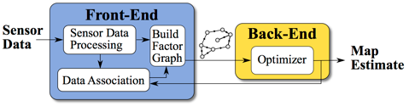
Graph Based SLAM
Every Node of the Graph corresponds to a pose of the robot during mapping
Every edge between two nodes correspond to the spatial constraint between them.
Goal Find a configuration of the nodes that minimises the error introduced by the constraints
Equation ……………
Front end and a back end operate in a cyclic fashion.

Slide 14
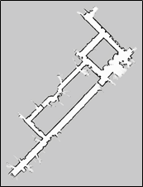
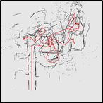
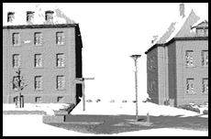
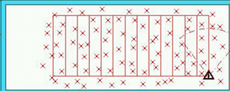
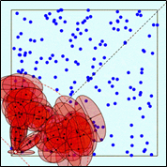
Representation
Grid Maps or scan
[Lu & Milios, 97; Gutmann, 98: Thrun 98; Burgard, 99; Konolige & Gutmann, 00; Thrun, 00; Arras, 99; Haehnel, 01;…]
Landmark Based
[Leonard et al., 98; Castelanos et al., 99: Dissanayake et al., 2001; Montemerlo et al., 2002;

Slide 15
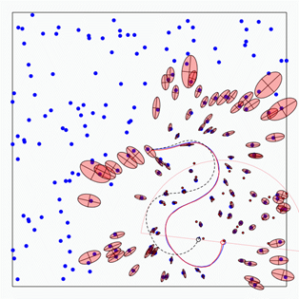
Feature based SLAM Algorithm
A robot is exploring an unknown Static or dynamic environment.
Given :
The robot’s Control
Observations of nearby features
Estimate :
Map of Features
Path of the robot

Slide 16
Image processing aspect of the Visual SLAM problem
Using efficient and better algorithm for image processing will make the SLAM algorithm computationally fast and also build rich 2D or 3D maps .
The image processing aspect of the SLAM problem
After the initial movement of the robot we make an observation
Essentially extract features from the RGB image and associate those features with the corresponding depth image.
Send those measurements as landmark position for the SLAM algorithm
Let the robot move again and take new observation do Scan matching/ registration from the previous landmark position and make an association and do image stitching and build a map.

Slide 17
Major steps and Image processing
S = (x,y,ɸ)
ϴ = { ϴ₁ ϴ₂ ……. ϴ _{N}} ϴ = (μ,𝚺,d) μ: 3D landmarks position ; 𝚺: landmark error covariance ; d: the landmark descriptor
Feature Extraction Algorithms
SIFT/ SURF
ORB (Oriented FAST rotated Brief)
Advantages of ORB over Sift and Surf
Compact Descriptors
Fast association due to binary nature

Slide 18
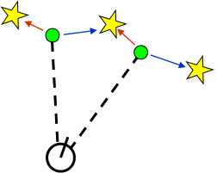
My approach and problem I tried to Address
Computational complexity
Data association
Building perceptually rich maps
RBPF
Utilizing ROS framework to take care of my transforms
ORB features
Not a rich visual map but Fast system
Two options
Pick the most probable match
Pick a random association weighted by the observation likelihoods
If the probability is too low generate a new landmark

Slide 19
Results
I was able to localize the robot with certain accuracy.
The image processing worked fine and the data association problem was successful addressed .
The backend RBPF needs to be improved.

Slide 20
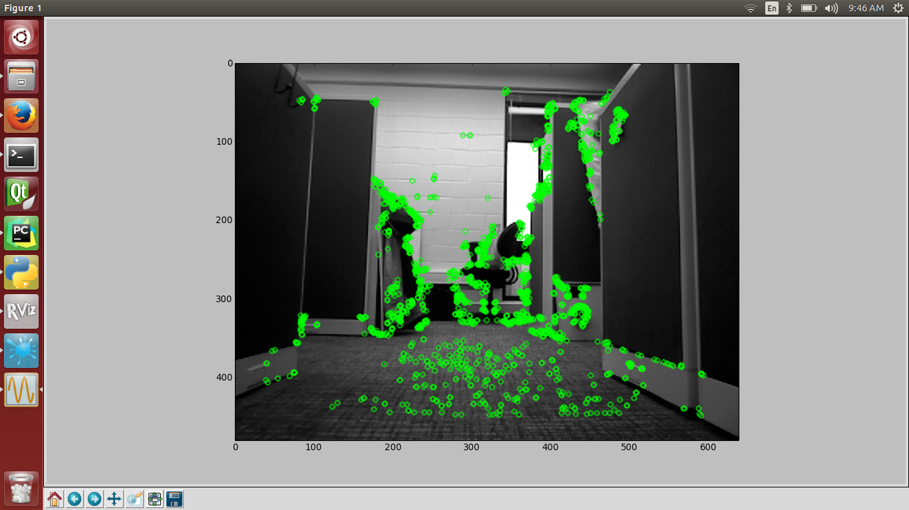

Slide 21
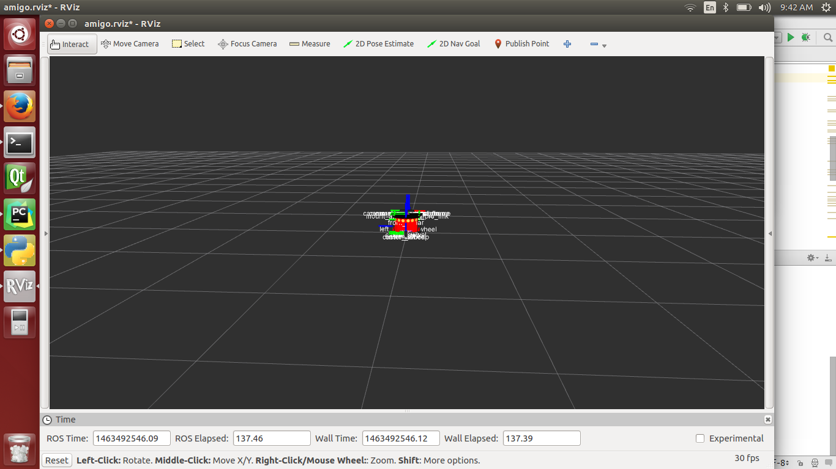

Slide 22
Future Work
Work with parallel threads to make the process faster
Tackle the dynamic environment
Improve accuracy
Let the robot take decisions Machine learning

